Slide 1
Software Engineering for Machine Learning
Dr. Shreyas Rao
Associate Professor, Dept. of CSIS, BITS-Pilani

Slide 2
AIMLCZG546
Lecture No. 3

Slide 3
Agenda
When to use Machine Learning
Requirements Engineering
From Goals to Requirements
GR4ML Modeling Notation
Measuring Goals

Slide 4
When to use ML
Geoff Hulten considers the following cases to use ML
Intrinsically hard problems
Understanding human language is extremely complex - ambiguity, sarcasm, context, and cultural nuances make it hard to write fixed rules
Rule-based systems (grammar rules, dictionaries) faile to handle real-world variability
2. Big Problems
For large, complex problems where manual rule-based systems become unmanageable and hard to maintain, ML offers a more scalable approach by automatically learning and adapting rules from data
Recommending songs to millions of users from tens of millions of tracks
3. Time-changing problems
Fraud patterns evolve constantly - new scams, new attack methods, new user behaviors. Rules like "flag transactions above ₹50,000 at night" quickly become outdated and Fraudsters adapt to bypass fixed rules

Slide 5
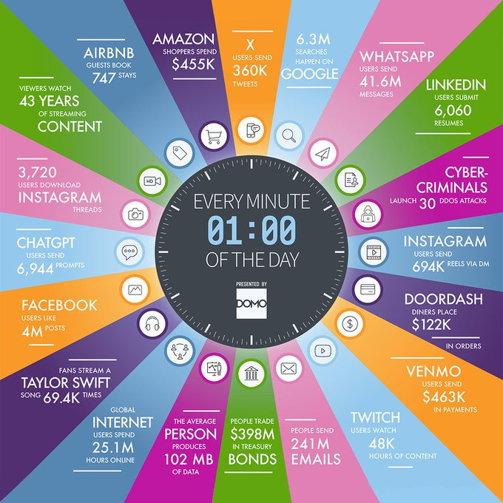
Big Data Deluge

Slide 6
Requirements Engineering
Traditional systems → deterministic (same input → same output)
ML systems → probabilistic (output depends on data and learned patterns)
Requirements must consider
Data quality and availability
Model behavior under uncertainty
Continuous learning and updates
Requirements Engineering in ML systems is about translating high-level goals into measurable, data-aware, and model-aware specifications

Slide 7
Goals
A goal in an ML system is a desired outcome of the overall system, aligned across model, system, user, and organizational levels, and ideally expressed in measurable terms
ML systems must align model goals, system goals, user goals, and organizational goals
Focusing only on model accuracy is insufficient for real-world systems
Good goals should be clearly defined and measurable
Example: A chatbot goal is not just “answer questions,” but also generate leads, reduce cost, and improve user experience

Slide 8
Goals
Goal Type | Focus | What it Answers | Typical Objectives | How Measured | E-commerce Example
Organizational | Business outcomes | Why are we building this system? | Increase revenue, profit, market share | KPIs: revenue growth, retention, churn | Increase overall sales revenue by 20%
Product | Product behavior & value | What should the product achieve? | Help users solve problems quickly | Task success rate, feature usage | Recommend relevant products to users
User | User needs & satisfaction | What do users want to accomplish? | Get accurate answers, complete tasks easily | User satisfaction, completion rate | Find desired products quickly and easily
Model | ML performance | How well does the model predict? | Classify correctly, detect fraud accurately | Accuracy, precision, recall, F1-score | Recommendation model achieves high click-through rate (CTR)

Slide 9
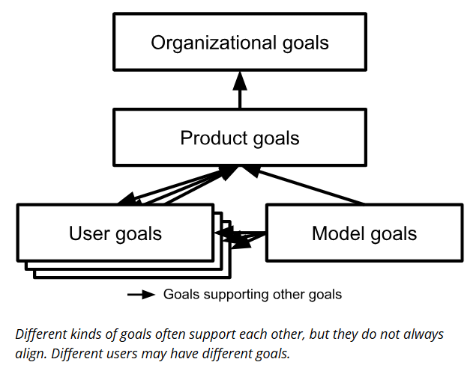
Relationship Between Goals
Goals across levels are interconnected and hierarchical
Goals may:
Support each other (accuracy improves user experience)
Conflict (accuracy vs latency, cost vs quality)
Requires trade-offs and prioritization

Slide 10
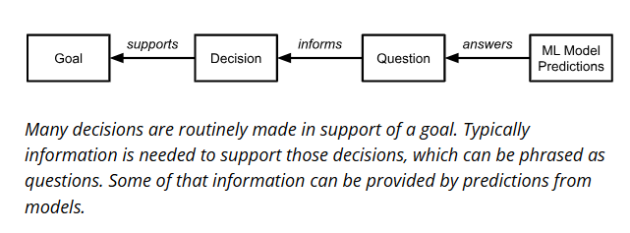
From Goals to Requirements
Understanding the goals of an organization and the goals of individuals within it, we can
Explore the decisions that people routinely make within the organization to further their goals
Ask which of those decisions could be supported by predictions
Which of those predictions can be supported with machine learning
Connection from goals to questions and predictions has been formalized in the conceptual modeling notation GR4ML

Slide 11
GR4ML Modeling Notation
[R6 - https://www.cs.toronto.edu/~soroosh/gr4ml_introduction.html]

Slide 12
Why we need GR4ML
Organizations struggle to apply ML effectively
Gap between business needs and ML solutions
ML projects involve requirements, data, algorithms, deployment
Need a structured approach

Slide 13
What is GR4ML?
Conceptual modeling framework
Supports requirements elicitation, design and development of Machine Learning solutions
Aligns ML systems with business goals
Core Idea
ML is not just algorithms
Requires alignment of business, analytics, and data
GR4ML connects all three layers

Slide 14
Three Views in GR4ML
Business View
Analytics Design View
Data Preparation View

Slide 15
Business View (Why?)
Identifies actors, goals, and decisions
Defines business objectives
Answers: Who needs ML and why?
Aim
Facilitate the elicitation and clarification of ML requirements in business contexts
Support analysis of those requirements (e.g., prioritization)
Ensure the alignment of business and analytics strategies
The main modeling elements are Actors, Strategic Goals, Indicators, Decision Goals, Question Goals, and Insights

Slide 16
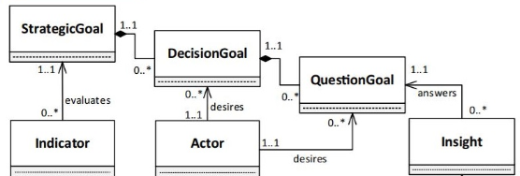
Business View
StrategicGoal → High-level business objective the organization aims to achieve
DecisionGoal → Specific decisions that need to be made to fulfill strategic goals
QuestionGoal → Questions that must be answered to support decision-making
Insight → Data-driven answers or findings that address the questions
Indicator → Metrics used to evaluate whether strategic goals are being achieved
Actor → Stakeholder or user who drives decisions and requires insights

Slide 17
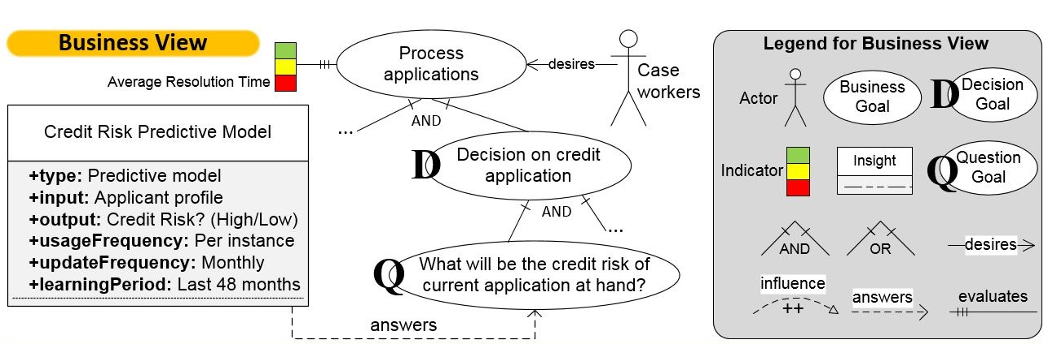
Business View - Toy Example
Scenario: Credit Risk Prediction in a Bank
The bank processes loan/credit applications.
The goal is to make good lending decisions quickly and safely.
Case worker is the bank employee who handles and evaluates credit/loan applications
UpdateFrequeuecy: monthly -> Every month, the bank retrains or refreshes the model using newer data.
learningPeriod - How much historical data was used to train the model

Slide 18
Analytics Design View (What?)
Defines type of analytics [Descriptive, Diagnostic, Predictive etc.]
Selects algorithms and techniques
Considers trade-offs
Answers: What analytics is needed?
Aim
Support exploration of alternate approaches for the analytical and machine learning problem at hand
Looks to facilitate design of (machine learning) experiments and identify trade-offs
Supports algorithm selection and monitoring their performance over time
The main modeling elements are Analytics Goals, Algorithms, Softgoals, and Influences

Slide 19
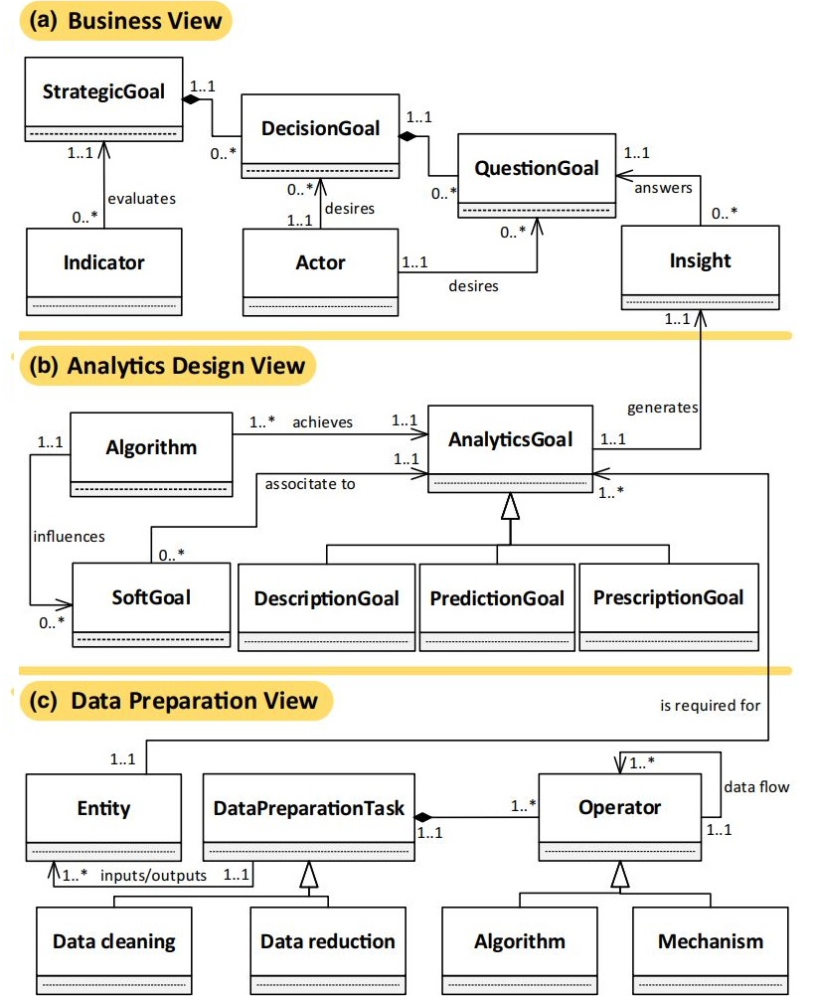
Analytics Design View
Algorithm → A specific computational method used to achieve analytics goals
AnalyticsGoal → The analytical objective that defines what insight needs to be generated
SoftGoal → Quality attributes (e.g., accuracy, interpretability) influencing algorithm choice
DescriptionGoal → Goal focused on understanding patterns or summarizing data
PredictionGoal → Goal focused on forecasting future or unknown outcomes
PrescriptionGoal → Goal focused on recommending optimal actions or decisions

Slide 20
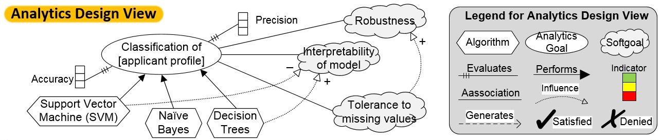
Analytics Design View – Toy Example

Slide 21
Data Preparation View (How?)
Defines data sources and features
Handles transformations and cleaning
Represents tables and attributes
Answers: How to prepare data?
Aim
Support the sharing and reuse of prepared data assets
Enhance data awareness among analytics users
Ease data understanding by providing a reference for data engineers (who prepare datasets) on data preparation activities.
The main modeling elements are Entities, Relationships Preparation Tasks, Operators, and Data Flows

Slide 22
Data Preparation View
Entity → Represents the data objects or tables used as input/output in the ML pipeline.
DataPreparationTask → Defines operations performed to transform raw data into usable format.
Operator → The method or function that executes a specific data preparation step.
Data Cleaning → Removes noise, missing values, and inconsistencies from data.
Data Reduction → Reduces data size or dimensionality while preserving important information.
Algorithm (in this view) → Technique applied within preprocessing (e.g., normalization, encoding).
Mechanism → The underlying process or implementation used to carry out data operations.

Slide 23
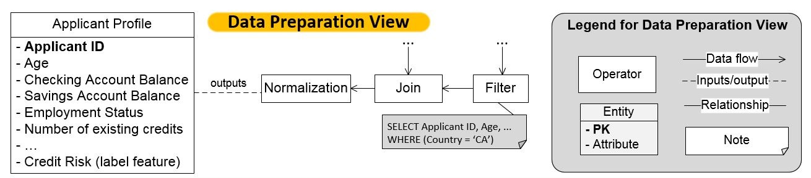
Data Preparation View – Toy Example

Slide 24
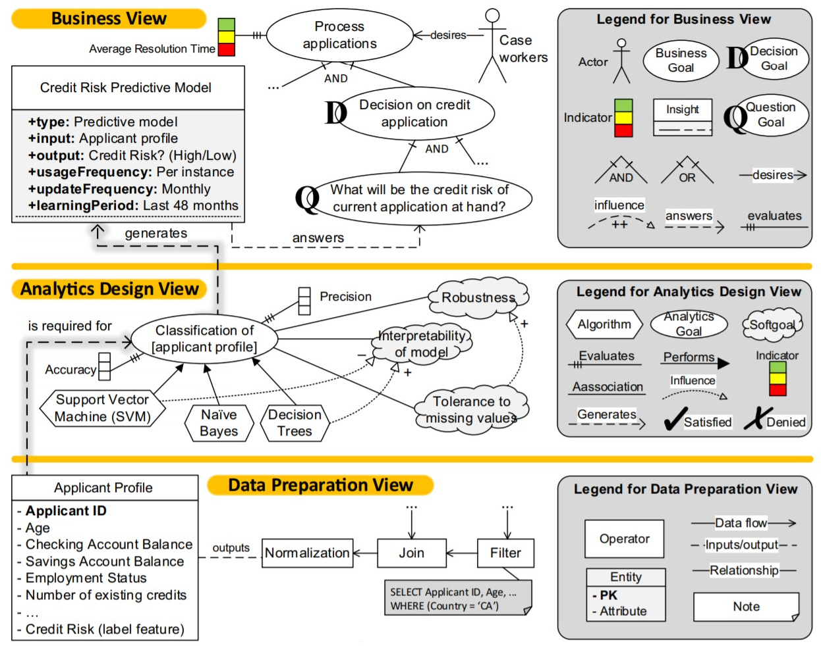
Toy Example - Putting it all Together

Slide 25
Measure
A measure (generally referred as metric) refers to a method or standard format of measuring something, such as the false-positive rate of a classifier or the number of lines of code written per week
A measure should:
Directly relate to a goal
Be quantifiable and objective
Be practical to collect
Examples:
Goal: Improve chatbot usefulness
Measures:
Task success rate
User satisfaction score
Conversation completion rate

Slide 26
Accuracy vs Precision
Accuracy - accuracy of a measurement process is concerned with how closely measured values (on average) represent the real value we want to represent
Ex: Accuracy of a user-satisfaction measure is evaluated in terms of how well the measured value represents the actual satisfaction of our users
Precision - refers to how reliably a measurement process produces the same result (whether correct or not)
Ex: if we repeatedly ask our users about their satisfaction, we will likely observe some variations in the measured satisfaction

Slide 27
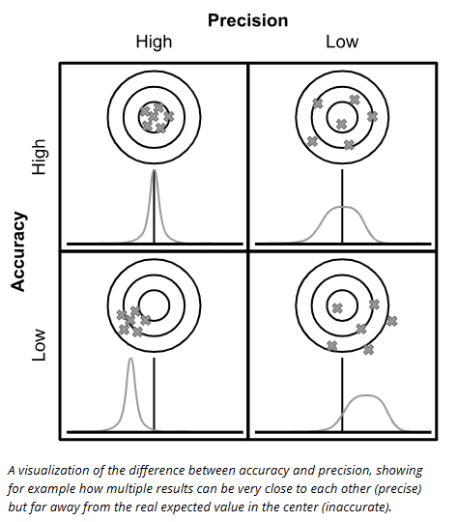
Accuracy vs Precision

Slide 28


